Slide 1
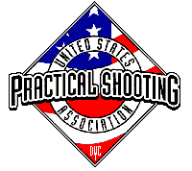
 | 28 Rounds v1
START POSITION: Standing in shooting area. Handgun, both hands touching one of set of X’s on the wall. PCC, weak hand touching on one of the X’s on the wall..
GUN READY CONDITION: Handgun loaded and holstered. PCC loaded with safety on, buttstock on belt. |  | SCORING: Comstock, 28 rounds, 140 points TARGETS: 14 USPSA SCORED HITS: Best 2 per paper START-STOP: Audible - Last shot RULES: USPSA current edition
STAGE PROCEDURE: Upon start signal, engage targets from the shooting area as they become visible.
Shooting Area
Setup Note: (14 target stands) 1) No Shoots in center area should force movement so 4 center targets can’t be engaged from one spot. 2) Middle shooting area should be 10 yards from target 3) Long head shots should be 15-20 yards.

